Slide 1
RELIABILITY
Ellie, Jed, Kevin, Steve, & Suzanna

Slide 2
Introduction
What is RELIABILITY

Slide 3
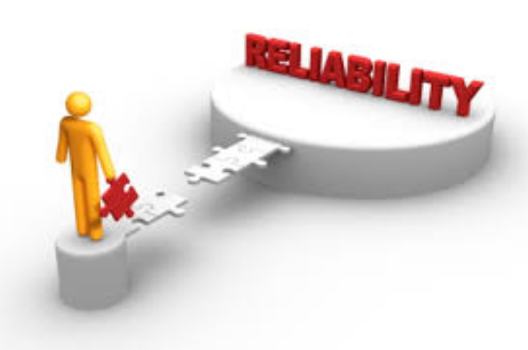
Introduction
HARDWARE
SOFTWARE
HUMAN

Slide 4
Ellie

Slide 5
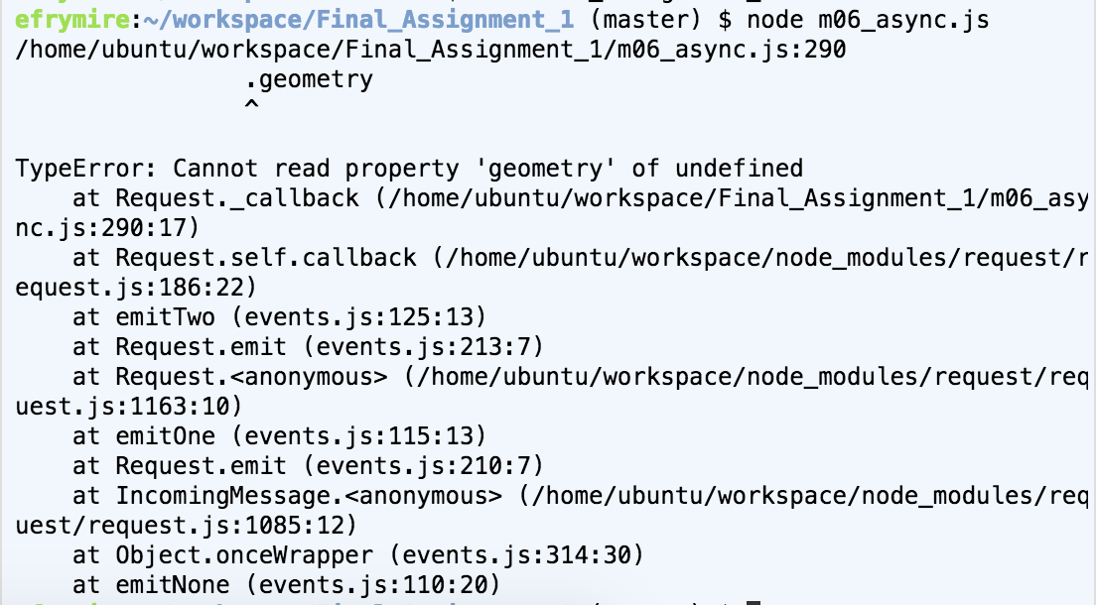
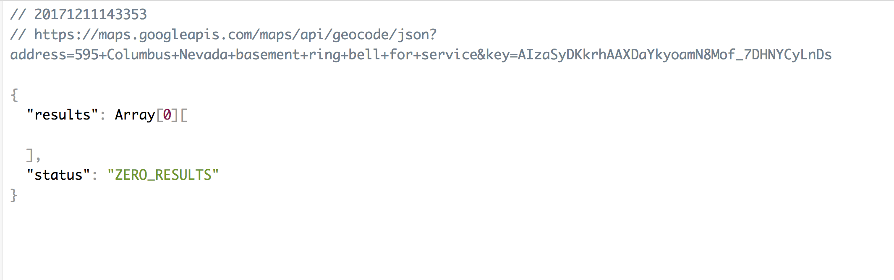
Reliability Issues for Ellie
Software Error: Address Data
”Cannot read property ‘geometry’ of undefined”
Some individual words would throw off my code entirely like “basement” or “kitchen”. This only happened for one or two addresses for the entire zone, but it would stop the entire code from running
A reliable code structure might receive this error, and skip that address to find the latlong of all others in that zone

Slide 6
Jed

Slide 7
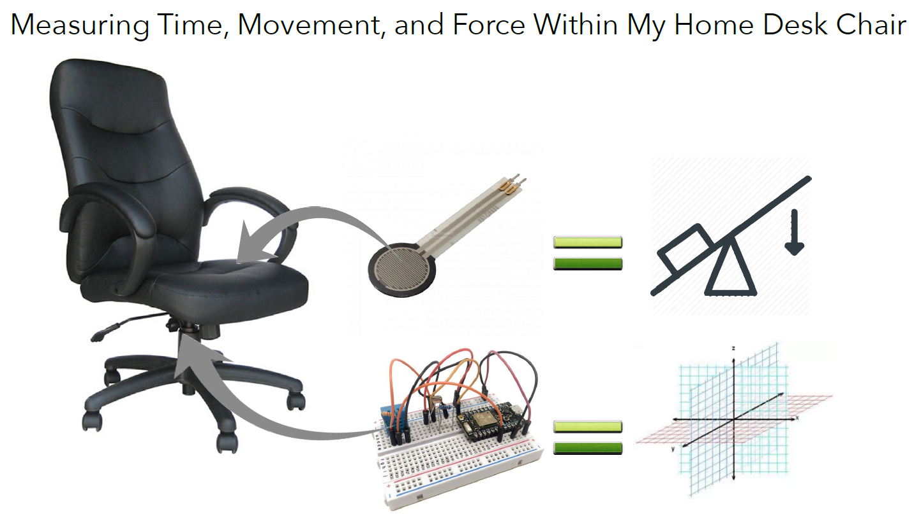

Slide 8
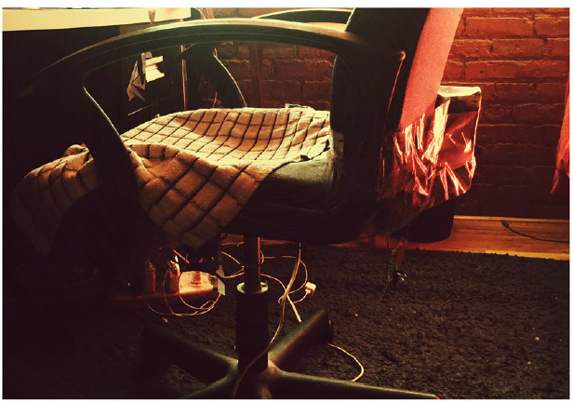
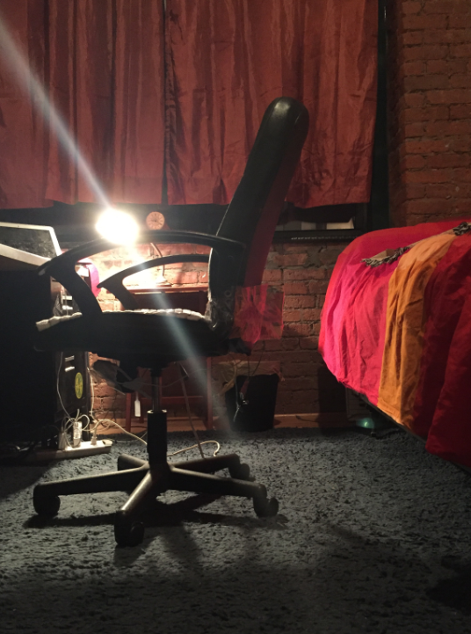
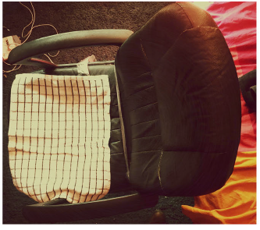

Slide 9
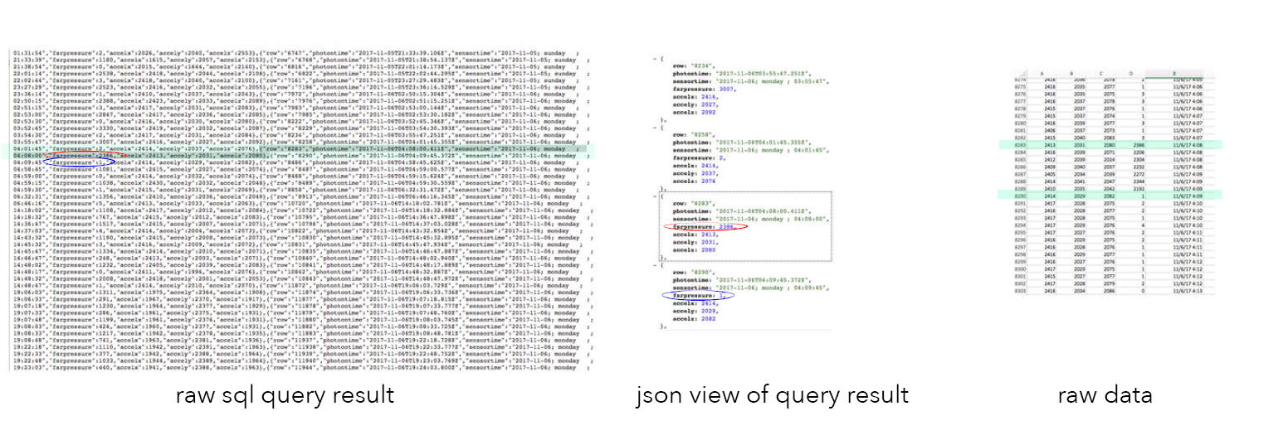
SQL query

Slide 10
Issues and Lessons Learned -- Reliability
• FSR Placement
• FSR Sensitivity
• Black (tea) Box
• Connectivity & Frequency
• Timezones & DST
• Tech Acquisitions

Slide 11
Kevin

Slide 15
Steve

Slide 16
Reliability Issues for Steve’s Pug Sensor
The design of the sensor’s interaction with the door latch was difficult to manage.
Tilt sensor was reliable because of the design.
Magnetic sensor had less reliability because of the design.
Had problems with both human, mechanical, and design errors.

Slide 17
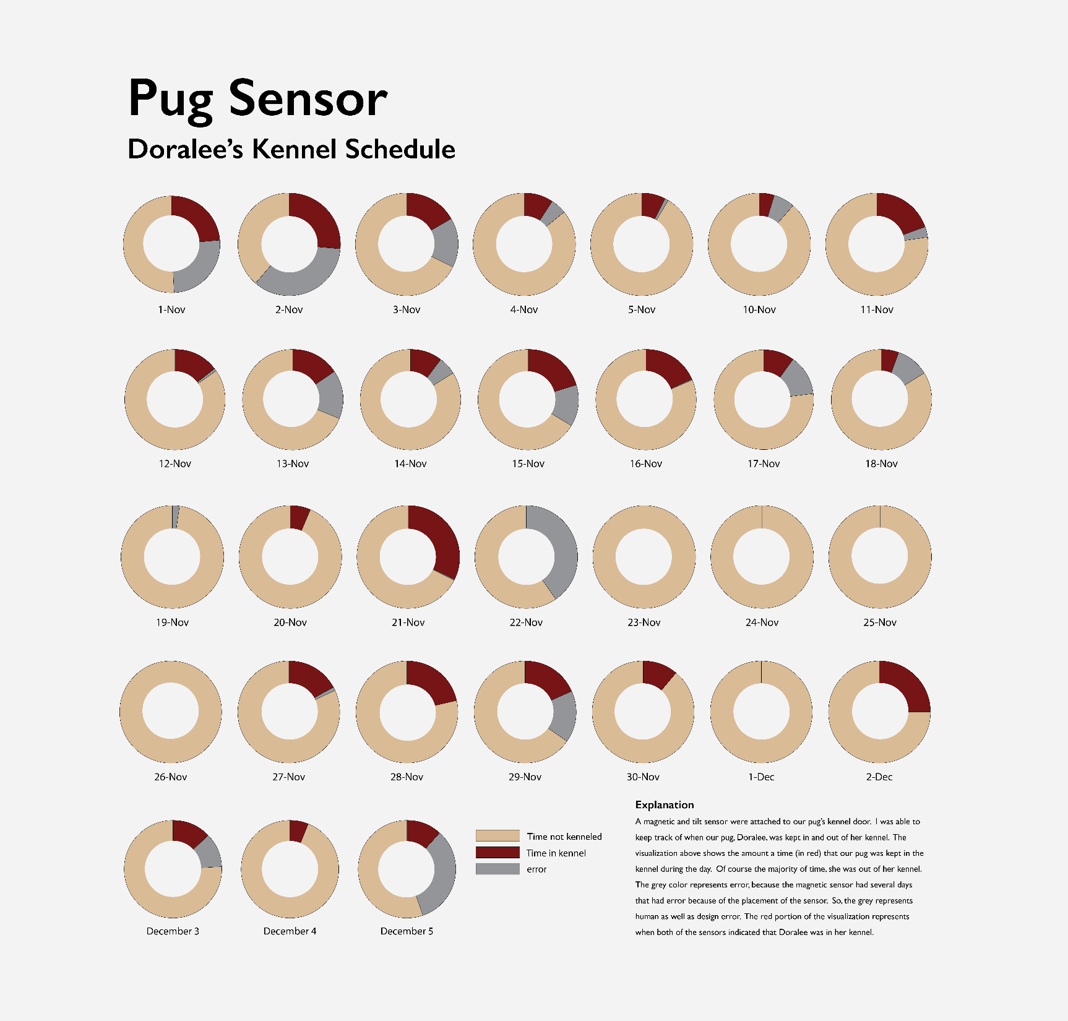

Slide 18
Suzanna

Slide 19
Data Structures - Final Project
By Suzanna Schmeelk

Slide 20
The importance of Reliability?

Slide 21
Reliability

Slide 22
Reliability
Accuracy
Integrity
Availability
Repeatability
What does it mean?

Slide 23
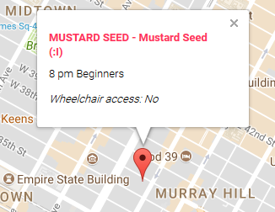
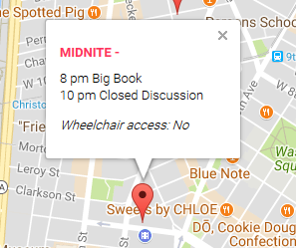
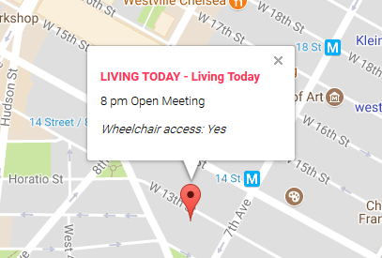
In AA Data
Title
Time
Special interest
Handicap accessibility
Location

Slide 24
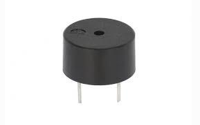
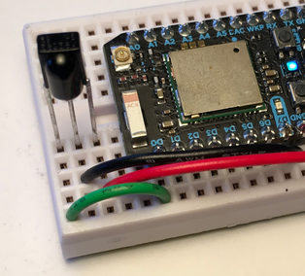
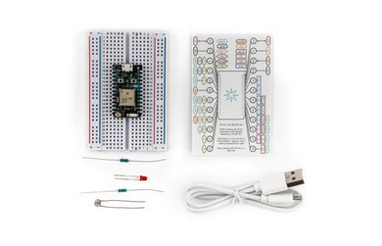
In Sensor Data
Hardware functioning
Network functioning
Amazon EC2 functioning
Node.js scripts functioning

Slide 25
Repeatability

Slide 26
Examples of repeatability importance...

Slide 27
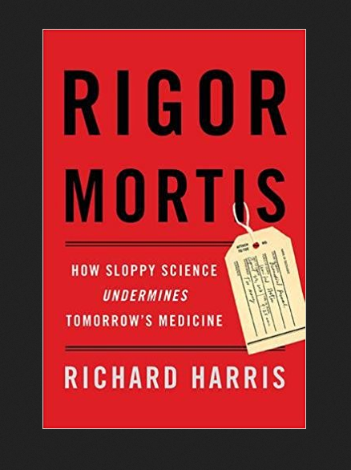
Book
‘Richard Harris (RH): Some people cite John Ioannidis’s notable paper, published in 2005, titled “Why Most Published Research Findings are False,” but even in that paper he’s citing previous concerns. CK Gunsalus at the University of Illinois reaches back to Demosthenes (384-322 BC), who said “nothing is easier than self-deceit.” That’s clearly the nub of the problem. I’m actually not convinced it’s a crisis. What is new is scientists are increasingly aware of these serious problems. That’s actually good. Nobody wants science to spin its wheels, and recognizing a problem is the first step toward solving it.’
http://retractionwatch.com/2017/04/04/failure-essential-part-science-qa-author-new-book-reproducibility/

Slide 28
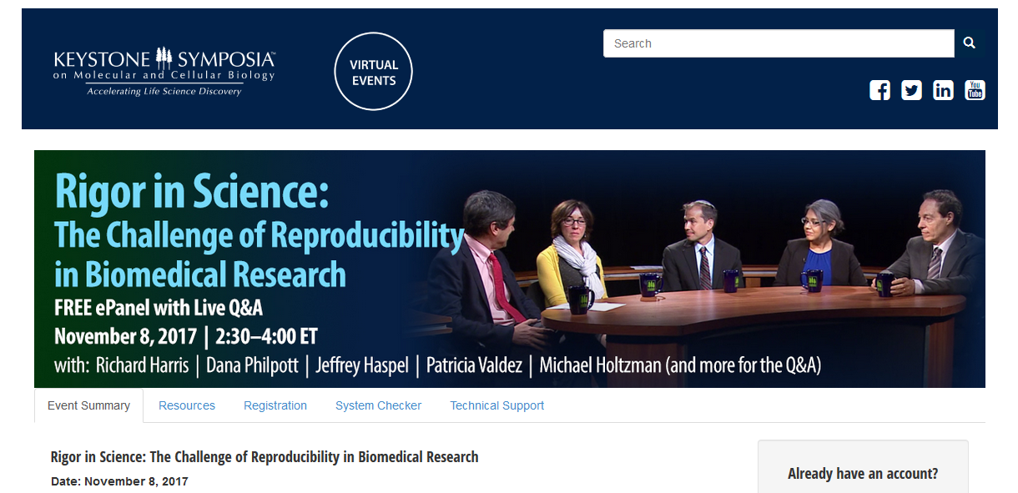
Reproducibility Challenges
https://virtual.keystonesymposia.org/ks/live/39

Slide 29
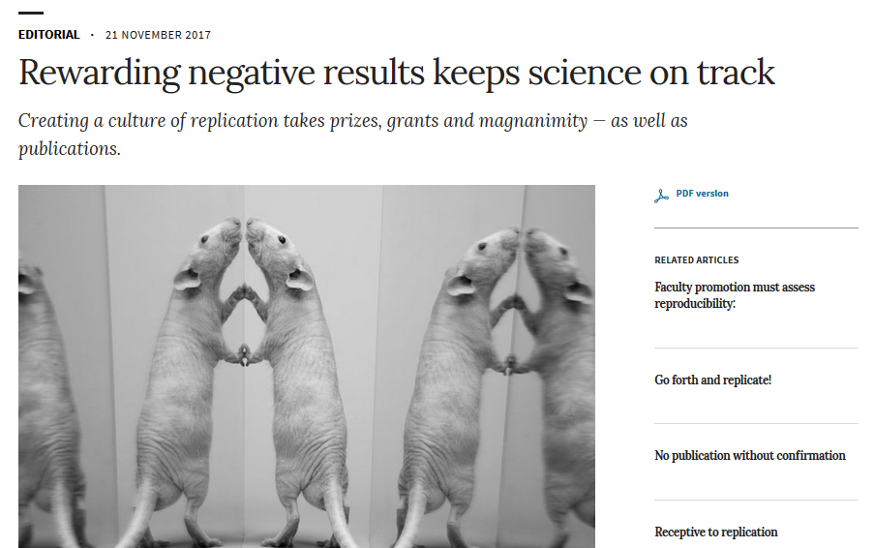
Reproducibility - Rewarding Negative Results
https://www.nature.com/articles/d41586-017-07325-2

Slide 30


Reproducibility

Slide 31
Conclusion
If we don’t have reliability in our data, then we don’t have much!
Topics:
Issues
Challenges
Ways to Change Research Culture

Slide 32
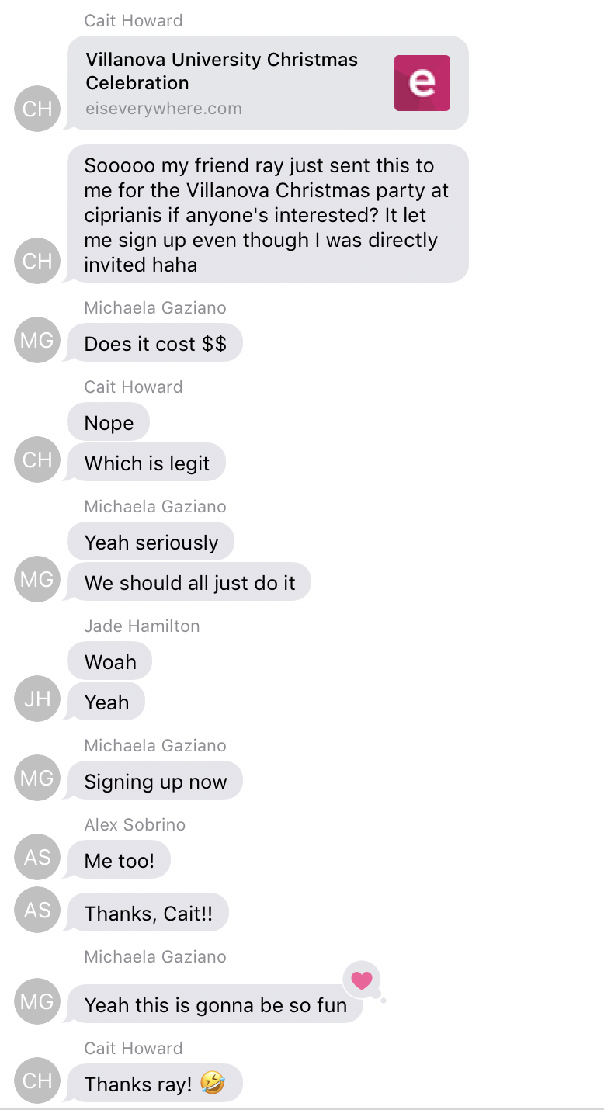
Villanova holds an annual Christmas party in NYC for high value donors in the area and scholarship students
One of the scholarship students forwarded his invitation to my friend Cait, who then shared the link with our friend group in a text thread.
The link, which was to register for the event, did not restrict use to only those who had been invited (software error)

Slide 33
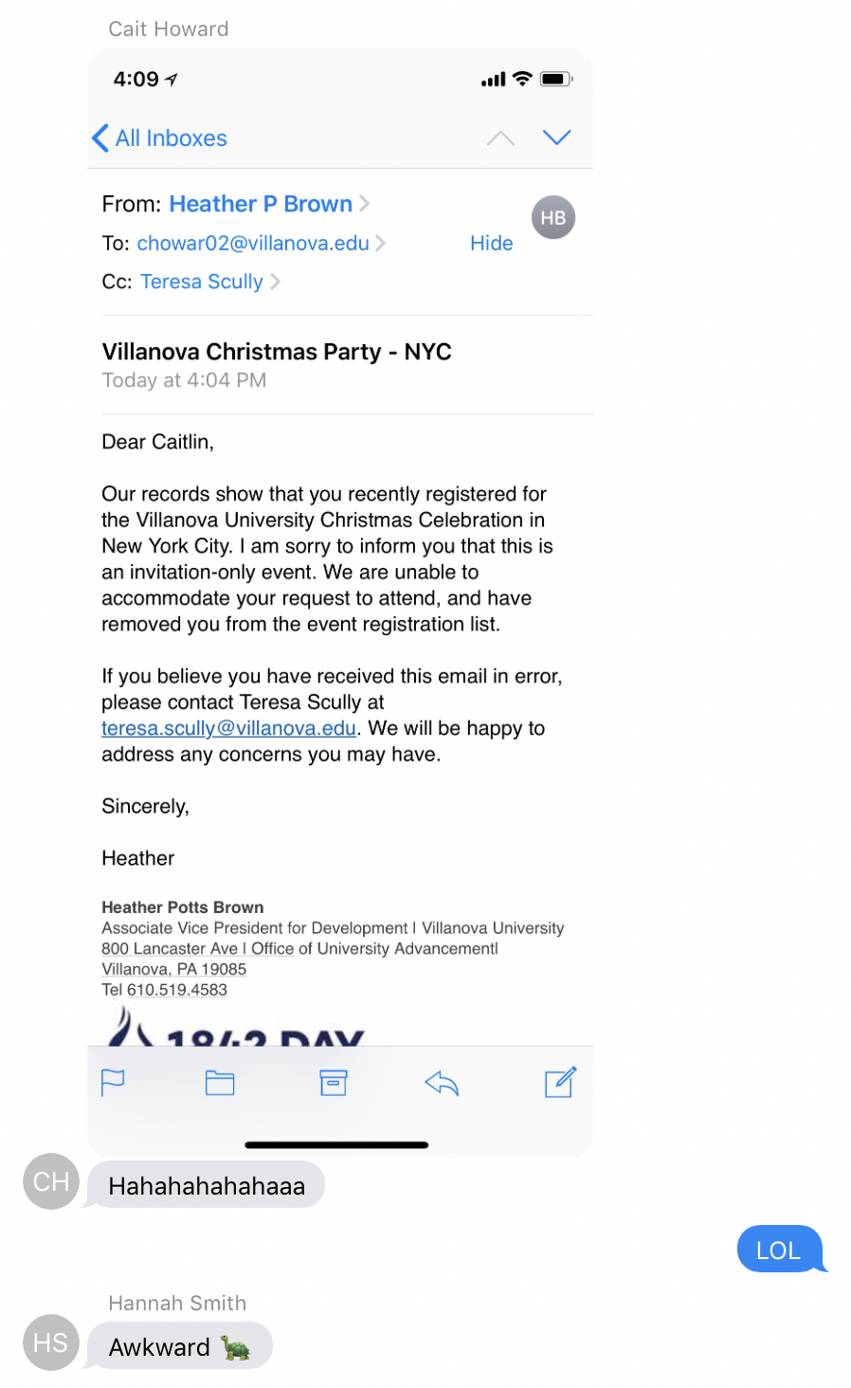
The event management team realized that the names on the registration list did not match the names on the invite list and sent a note to everyone who registered letting them know that they would not be able to attend

Slide 34
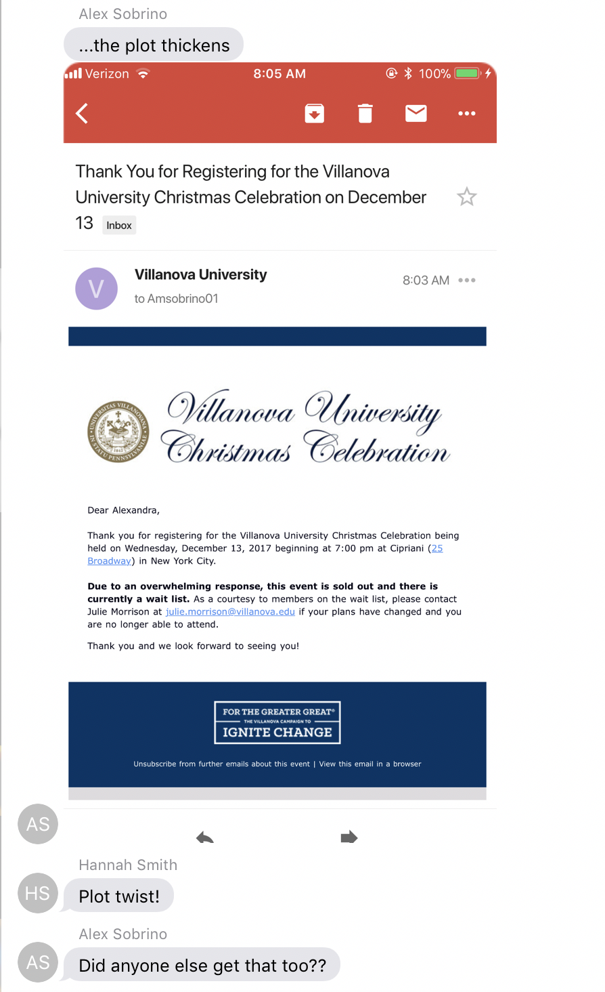
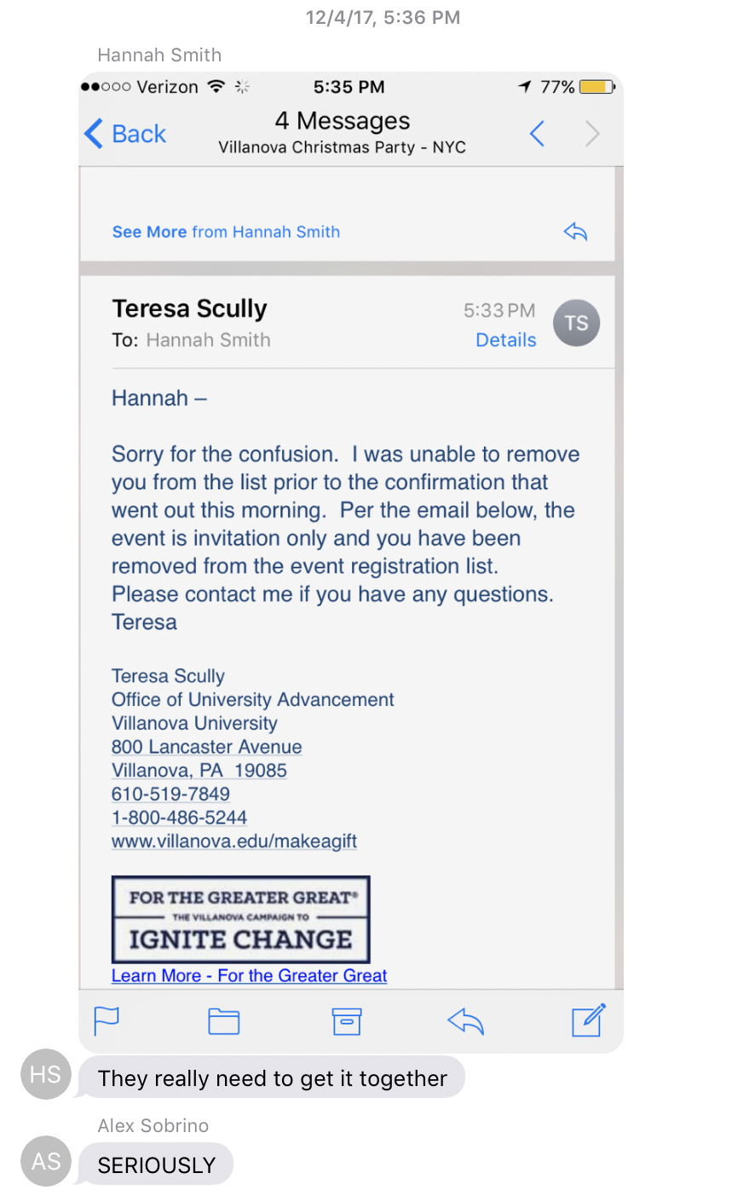
(Human Error) Although the event management team knew who was not allowed to attend, they did not remove them from the list
The team then sent out “thank you” emails to all who had registered, without first removing them from the list
This database and associated event system clearly did not work correctly and continued to not work correctly “even when things go wrong” as Kleppmann says.

Slide 35
THE END!

